Slide 1
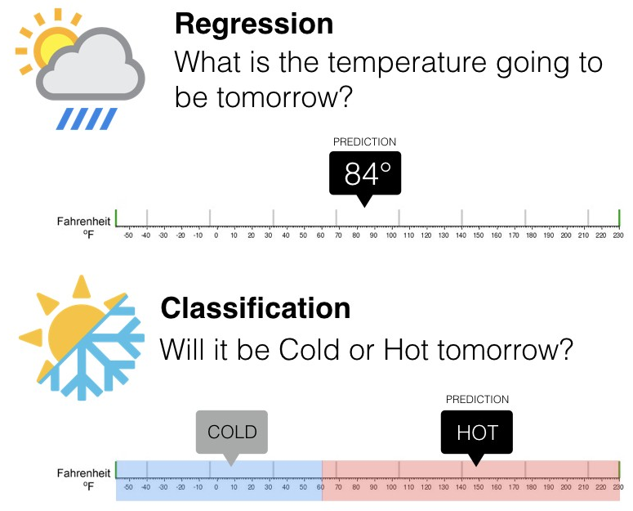
What is Classification?
It is a supervised learning algorithm where input data can be easily categorized, tagging data and classifying them. There can be binary classifiers with only two outcomes, or multiclass classifiers with more than two.
It can be performed on both structured and unstructured data, as it is the process of classifying a particular dataset. The process begins with estimating the class of given data points. Classes are often called targets, tags, or categories.

Slide 2
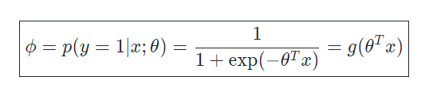
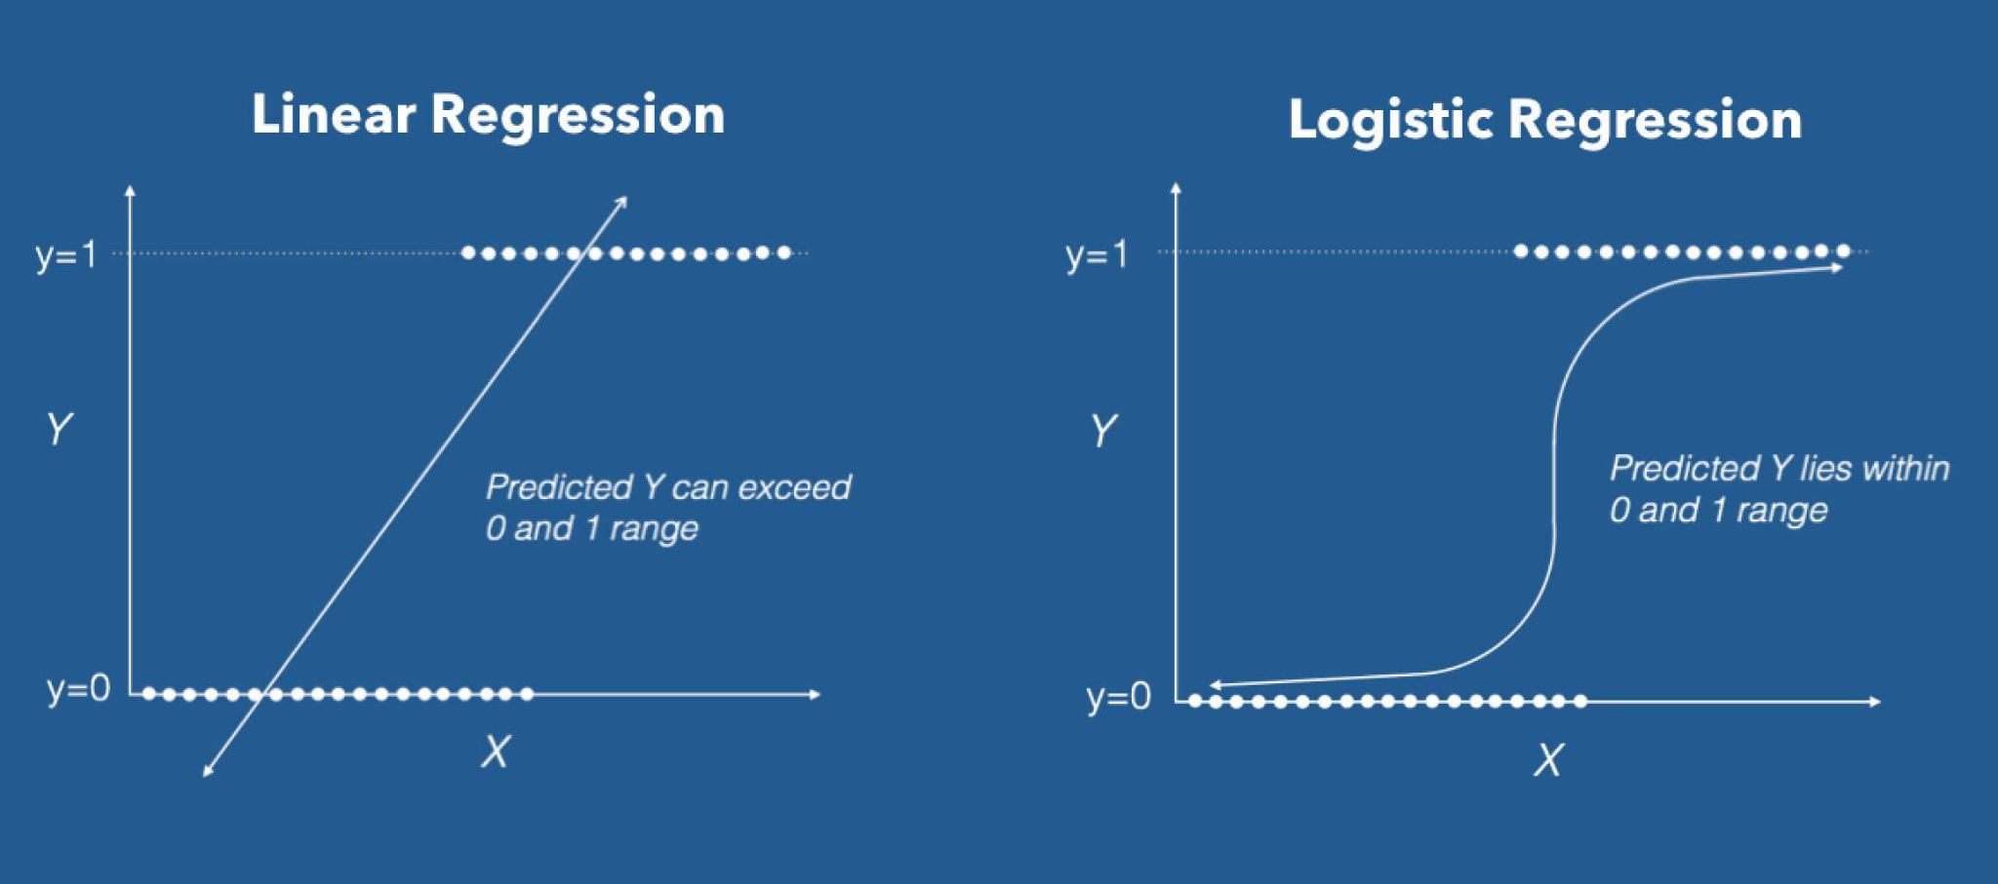
Logistic Regression
Logistic regression is a regression method that performs classification in which the dependent variable is a categorical variable. The aim is to establish a linear model between dependent and independent variables.
It works if the dependent variable can take 2 different values
Logistic regression produces a specific probability value between 0 and 1, rather than predicting exactly 0 or 1.
Yes/No
Spam/Not Spam

Slide 3
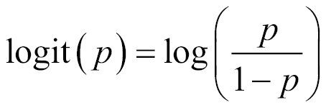
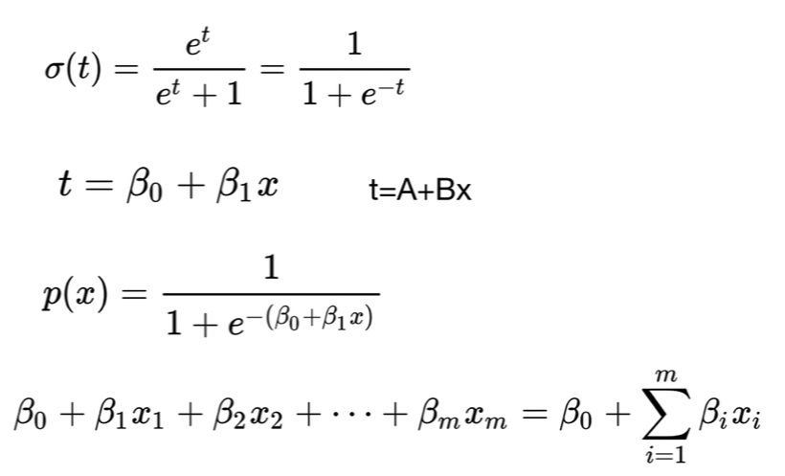
Logistic Regression
As in Linear Regression, the weighted sum of the features is taken, but instead of giving the result directly, the Sigmoid activation function is applied to the result
Used for binary classification
Our output will be a probability value between 0 and 1
It is a function with "S" characteristic

Slide 4
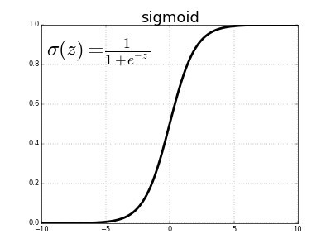
Sigmoid Function
The sigmoid function is an activation function that gives a probability value by compressing the output of the linear regression formula between 0 and 1. This means that the output value is between 0 and 1.
When the sigmoid activation function is used, small changes in the independent variables will cause a significant change proportionally on the dependent variable. No matter how much the independent variables change, the dependent variable will always be between 0 and 1

Slide 5
Measuring the Performance of the Classification Model

Slide 6
Classification Thresholding
The threshold is the value that determines which of the probability values estimated as a result of logistic regression will be accepted as true.
E.g; If a model that classifies mails according to whether they are spam is given a threshold of 0.5:
Emails with a spam probability greater than or equal to 0.5 are classified as spam.
Emails with a spam probability of less than 0.5 are classified as non-spam.

Slide 7
True vs False & Positive vs Negative
In order to measure the performance of the classification model, it is necessary to use some data. These data are True Positive, True Negative, True Positive and False Positive values.
Positive vs Negative
Our True and False values are basically our label classes.
E.g; in an email spam classification model can be assumed as:
“Spam” = Positive
“Not Spam” = Negative
True vs False
Our Positive and Negative values are related to the prediction results of our model.
E.g; When the model predicts a mail that is actually “Spam” (Positive) as “Not Spam” (Negative), this prediction becomes a False Negative prediction.
This is because our model performs a Negative prediction and this prediction is also False.

Slide 8
Confusion Matrix
It is a matrix in which the actual class value used to evaluate the performance of the classification model is compared with the predicted class value.
Positive: “Spam” Negative: “Not Spam”
True Positive: A result in which the model correctly predicts the positive class Truth: E-mail is Spam Prediction: E-mail is Spam | False Positive: It is a result in which the model cannot accurately predict the positive class Truth: E-mail is not Spam Prediction: E-mail is not Spam
False Negative: It is a result in which the model cannot accurately predict the negative class Truth: E-mail is not Spam Prediction: E-mail is Spam | True Negative: A result for which the model correctly predicts the negative class Truth: E-mail is not Spam Prediction: E-mail is not Spam

Slide 9
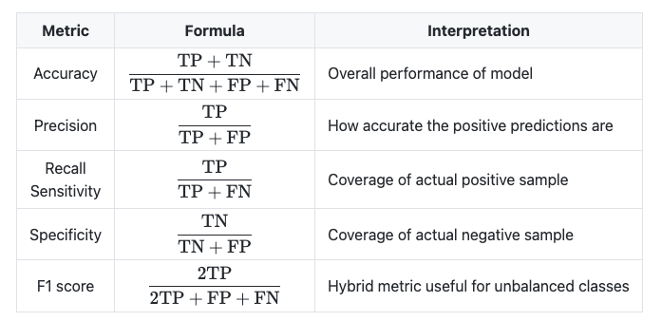
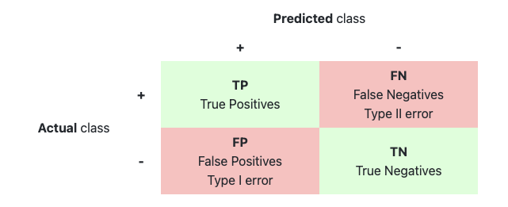
Accuracy
The Accuracy metric is the number of correctly guessed predictions divided by the number of all predictions.
Other classification metrics were needed because they were not sufficient on their own for imbalanced datasets.

Slide 10
Why Accuracy Alone Isn't Enough?
Total Mail Count: 100
Spam E-Mail Count: 98
Not Spam E-Mail Count: 2
Hypothesis: Modelin tüm mailler için Spam tahmini gerçekleştirmesi
True Positive 98 | False Positive 2
False Negative 0 | True Negative 0

Slide 11
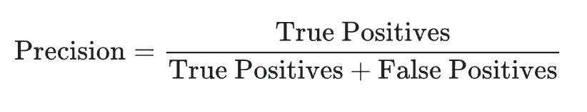
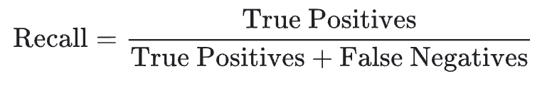
Precision & Recall
Precision and Recall are two metrics that measure the performance of the classification model.
Precision: It is a metric that seeks to answer of “How many of the positive predictions were correct?”
We can use the following Precision formula to answer this question:
Recall: It is a metric that seeks to answer of “How many of the actually positive results were predicted correctly?”
We can use the following Recall formula to answer this question:

Slide 12
Precision & Recall Calculation
True Positive 176 | False Positive 97
False Negative 64 | True Negative 70
Precision = 176 / (176 + 97) => 176 / 273 => 0.64
Recall = 176 / (176 + 64) => 176 + 240 => 0.73

Slide 13
When to Use Precision and Recall?
Precision: Precision is given priority when obtaining any False Positive value cannot be afforded. In other words, high precision is sought when no false detection can be afforded.
E.g; In a zombie apocalypse, you try to welcome as many healthy people (Negative) as possible into your safe zone, but you really don't want to accidentally pass a zombie (Positive) into the safe zone (False Positive). If your method causes some healthy people to accidentally avoid the safe zone, this is an acceptable method.
Recall: Recall is given priority when obtaining any False Negative value cannot be afforded. In other words, a high recall value is sought when no detection can be missed.
E.g; It's okay to classify a healthy person (Negative) as cancerous (Positive) (False Positive) and to have more medical tests, but it's definitely not correct to classify a cancer patient (Positive) as healthy (False Negative).

Slide 14
Confusion Matrix - Precision
Positive: “Not Zombie” Negative: “Zombie”
True Positive Truth: Not Zombie Prediction: Not Zombie | False Positive Truth: Zombie Prediction: Not Zombie
False Negative Truth: Not Zombi Prediction: Zombie | True Negative Truth: Zombie Prediction Zombie

Slide 15
Confusion Matrix - Recall
Positive: “Cancer” Negative: “Not Cancer”
True Positive Gerçek: Cancer Model Tahmini: Cancer | False Positive Gerçek: Not Cancer Model Tahmini: Cancer
False Negative Gerçek: Cancer Model Tahmini: Not Cancer | True Negative Gerçek: Not Cancer Model Tahmini: Not Cancer

Slide 16
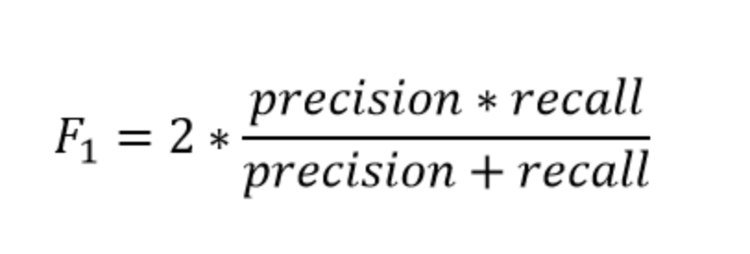
F1 Score
Although Precision and Recall may be preferred over each other in some cases, it may not be known which of the two will give better results in the model everytime. The F1 Score metric is equal to the harmonic mean of the Precision and Recall metrics, so it combines these two metrics.
The reason for the harmonic mean is that if the arithmetic average was taken, if one of the precision or recall values was 0, these values would not contribute to the average. In addition, precision and recall values in harmonic mean play an equal role in increasing the F1 Score.

Slide 17
Classification Threshold, ROC Curve & AUC
As the classification threshold changes, your Complexity Matrix values will also change depending on the threshold. Since the performance of the model will vary depending on the threshold, there are certain performance consequences for certain thresholds. To measure the performance of the model to its full extent, it is necessary to look at the ROC Curve and the AUC.
ROC Curve: A graph showing the performance of a classification model at all classification thresholds
AUC: It stands for "Area Under the ROC Curve". AUC measures the entire two-dimensional area under the entire ROC curve from (0.0) to (1.1)

Slide 18
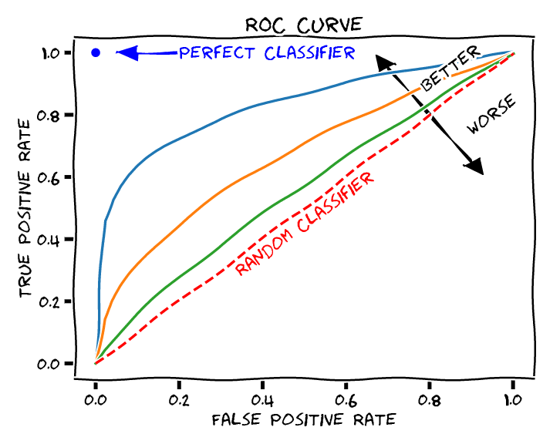
Classification Threshold, ROC Curve & AUC
The ROC Curve has two parameters:
True Positive Rate (TPR): Recall value
False Positive Rate (FPR): How many of the negative values are predicted incorrect?
A ROC curve plots TPR vs FPR at different classification thresholds. Lowering the classification threshold classifies more items as positive, increasing both False Positives and True Positives.
To calculate points on a ROC curve, a logistic regression model with different classification thresholds would have to be evaluated multiple times, but this method would be inefficient. We can do this more effectively by using AUC.

Slide 19
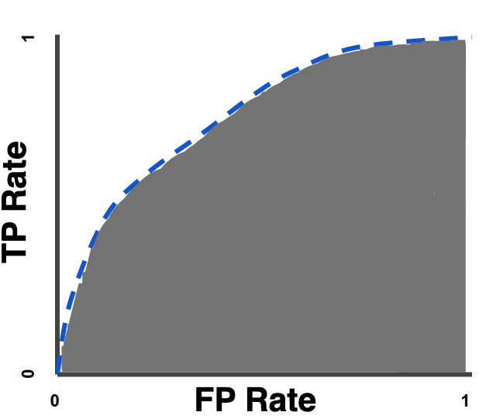
Classification Threshold, ROC Curve & AUC
AUC provides an aggregated measure of performance across all possible classification thresholds. In other words, our AUC determines how well our model classifies classes.
The AUC value is between 0 and 1.
At AUC = 0, the model performs every classification incorrectly
At AUC = 1, the model performs every classification correctly

